Slide 1
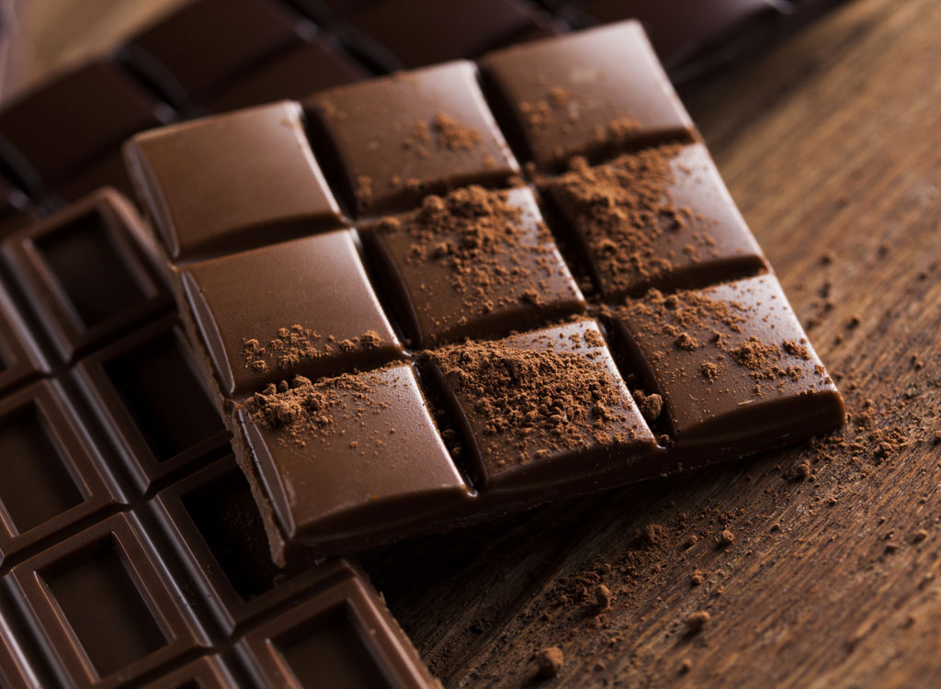
Exploratory Data Analysis
CHOCOLATE BAR RATINGS

Slide 2
TABLE OF CONTENT
INTRODUCTION
UNDERSTANDING THE DATA
QUESTIONS
HYPOTHESIS
DATA CLEANING
DATA VISUALIZATION
RECOMMENDATION
CONCLUSION
ACKNOWLEDGEMENT

Slide 3
INTRODUCTION
Chocolate is one of the most popular candies in the world. Each year, residents of the United States collectively eat more than 2.8 billions pounds. However, not all chocolate bars are created equal! This dataset contains expert ratings of 1,795 individual chocolate bars, along with information on their regional origin, percentage of cocoa, the variety of chocolate bean used and where the beans were grown.

Slide 4
UNDERSTANDING THE DATA
From the flavors of cocoa data given, the following was identified
There are nine columns and 1795 rows
Specific bean origin has a relation to broad bean origin
The company location has a relation to the company name
Bean type has 49.4% missing values
The bean type with the highest occurrence is Trinitario (23.4%)
The broad bean origin with the highest occurrence is Venezuela (11.9%)

Slide 5
QUESTIONS
Which countries are the top 10 producers of beans used for chocolate bars?
What is the rating with the highest frequency?
How many chocolate bars have a 100% rating?
Which countries are the top 10 bean suppliers?
Which 10 companies have the highest ratings?
What is the average rating for each year?
Is there a relationship between the origin of a bean and the average rating of bars made from it?
What is the average rating of chocolate bars made up of 100% cocoa?
What is the average rating of chocolate bars made up of 70% cocoa?

Slide 6
HYPOTHESIS
Null hypothesis
There is no relationship between the percentage of cocoa in a chocolate bar and its rating.
Less than 50% of raters will give chocolate bars ratings higher than 50%.
The average percentage of cocoa in bars does not change as the years go by.
The average rating of chocolate bars decreases over the years.
Alternate hypotheses
There is a relationship between the percentage of cocoa in a chocolate bar and its rating.
More than 50% of experts will give chocolate bar ratings higher than 50%.
The average percentage of cocoa in bars changes as the years go by.
The average rating of chocolate bars increases over the years.

Slide 7
DATA CLEANING
Checking for null values
Checking for outliers
Renaming columns

Slide 8
DATA ANALYSIS
Tools used:
Jupyter Notebook via the cocalc, Collaborative Calculation and Data Science
Python 3
Google Sheets - For exploratory data analysis report
Google Slides - For Presentation
Imported libraries
pandas
matplotlib
Seaborn

Slide 9
DATA VISUALIZATION
Data visualization is the graphical representation of information and data. In the following slides, graphs will be used to determine the relation between the various columns in the dataset and to provide an accessible way to see and understand trends and patterns in data.

Slide 10
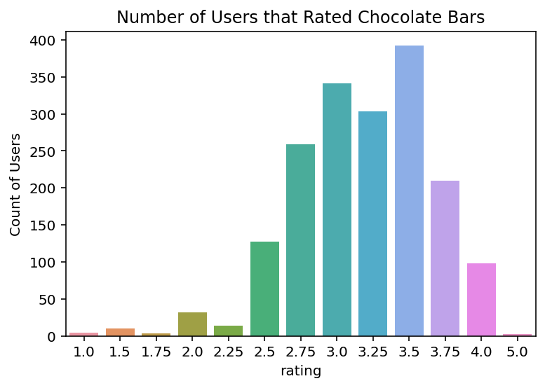

Slide 11
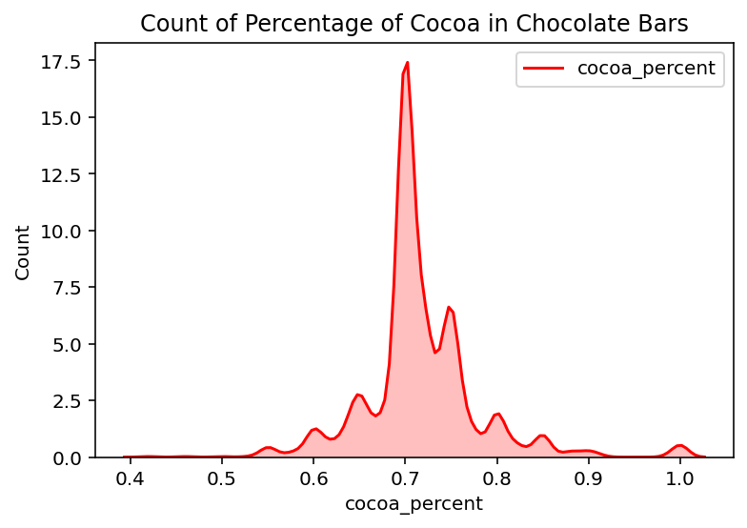

Slide 12
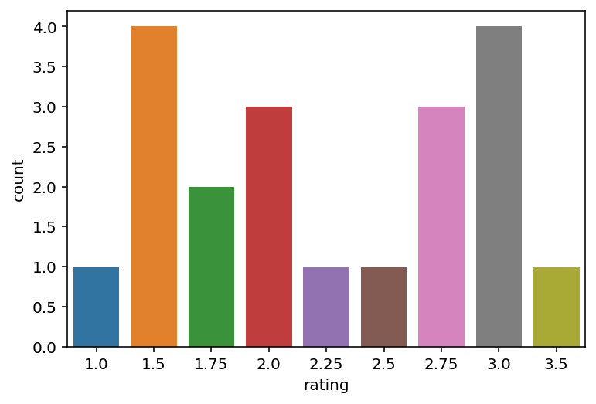
Ratings of Chocolate Bars with 100% Cocoa

Slide 13
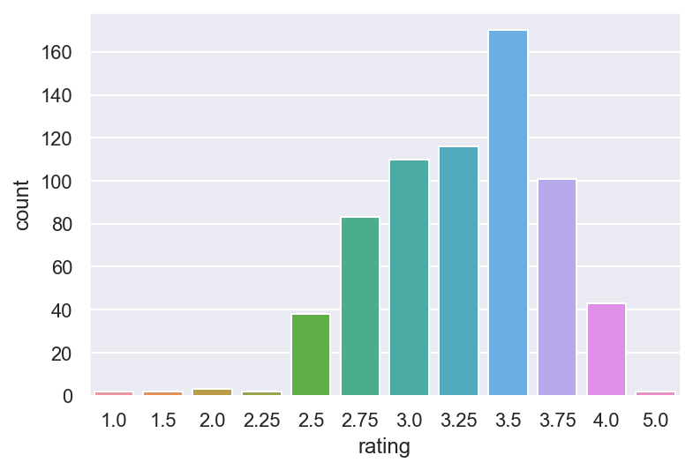
70% Cocoa in production

Slide 14
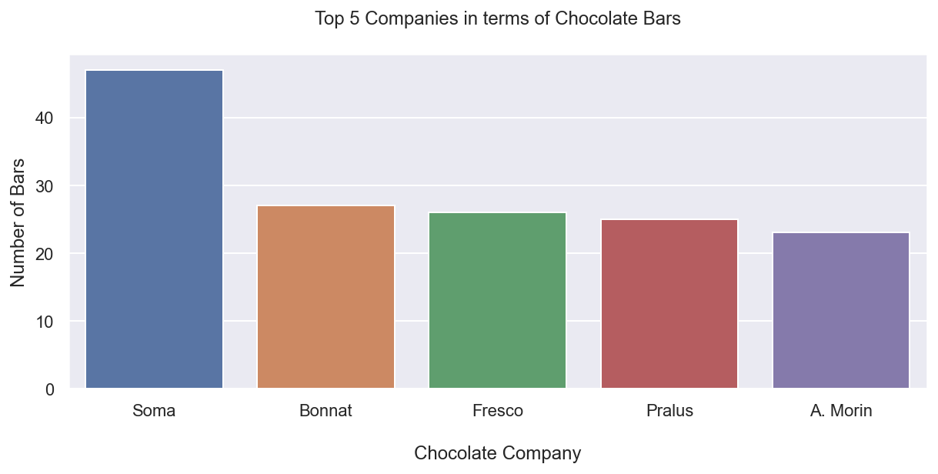
Companies that produced the highest number of chocolate bars over 11 years in review.

Slide 15
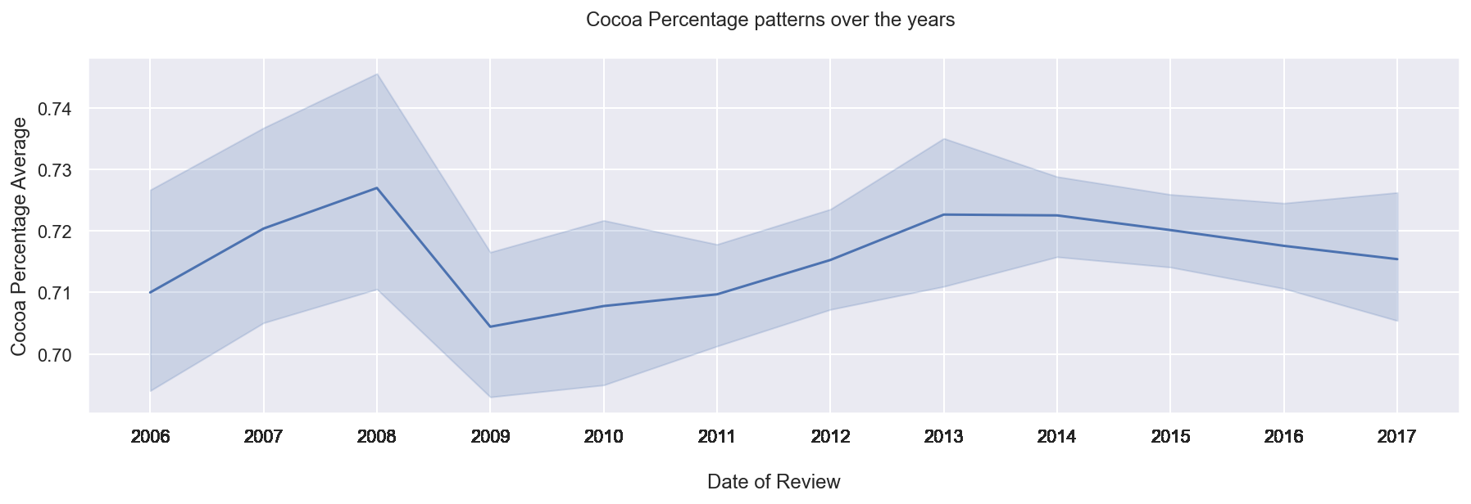
Cocoa percentage pattern over the period of 11 years

Slide 16
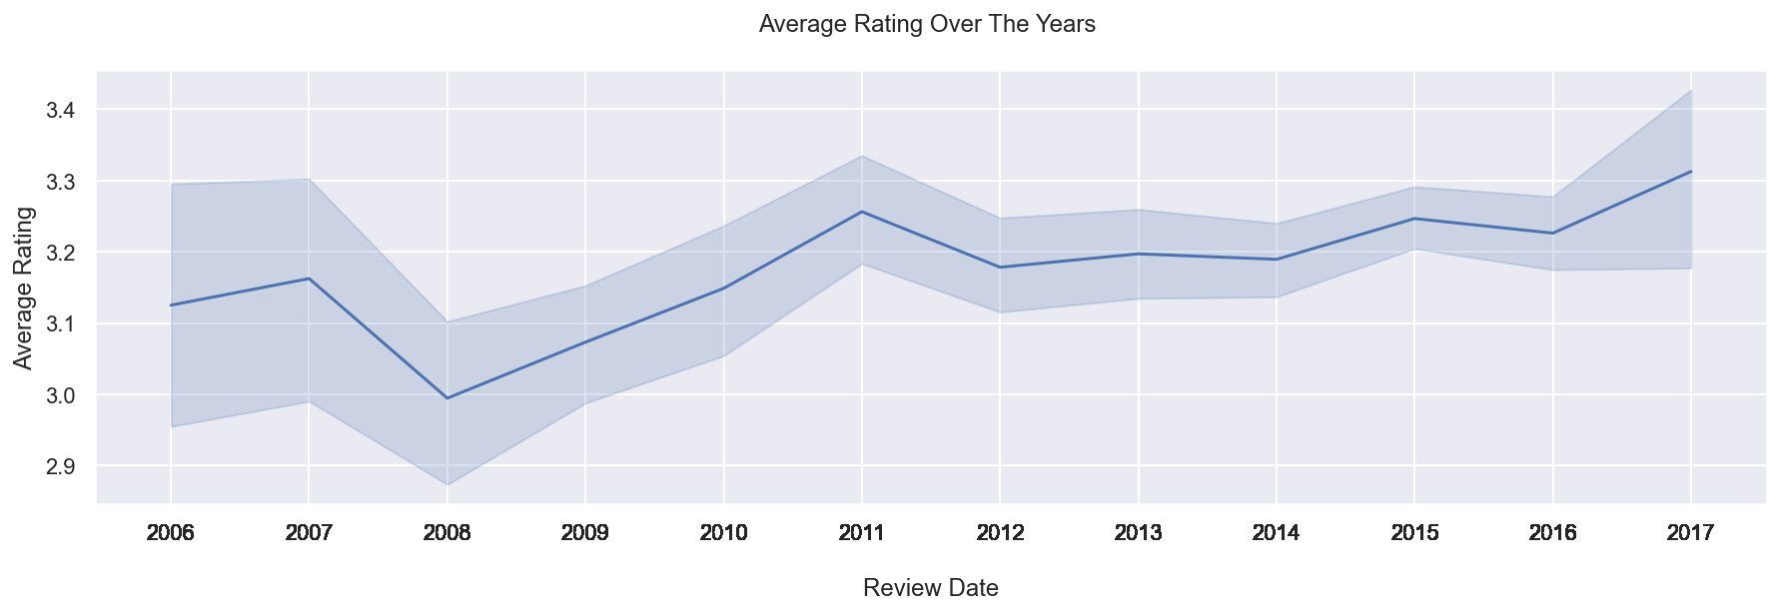
Average rating of flavour over a period of 11 years

Slide 17
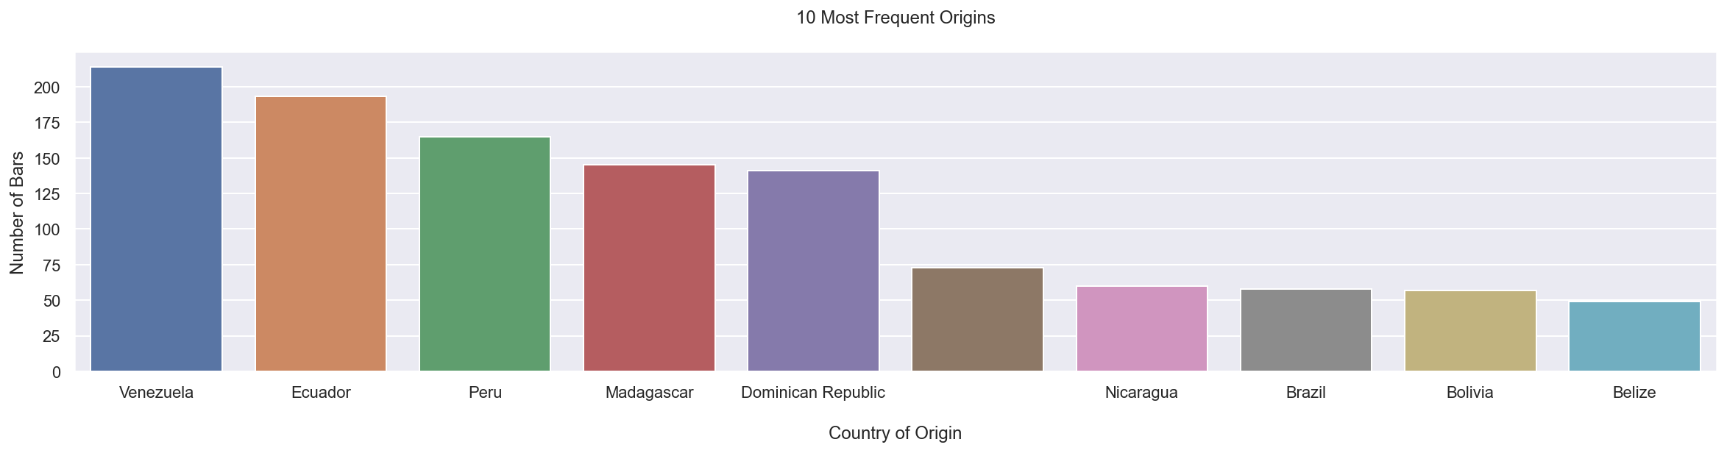
Countries with the highest supply of cocoa beans

Slide 18
RECOMMENDATIONS
Based on the analysis and conclusions, we recommend that for a company to maximise profit, 70% of cocoa beans in chocolate will give the best flavour.
Majority of the beans come from the South American continent and so may be cheaper getting cocoa beans from such areas.
For a company to maximise chocolate production, techniques used in the Soma company can be adapted to suit the local company.

Slide 19
CONCLUSION
.
The data can help alter consumer preference.
The findings and observations shown above in the graphs represented can be used for chocolate business advisory.
This data can be used to pitch ideas to chocolate manufacturing companies.
This data can also be used by companies to increase sales or alter consumer preference of certain chocolate bars.

Slide 20
ACKNOWLEDGEMENT
This work was prepared by
Benedict Nartey - Benedict.Nartey@azubiafrica.org
Barbara Asiamah - Barbara.Asiamah@azubiafrica.org
Berlinda Asiedu - Berlinda.Asiedu@azubiafrica.org
Belinda Osei Tutu - Belinda.Osei-Tutu@azubiafrica.org

